Slide 1
SC Underwater Robotics: Electrical Team
Team Lead: Ivan Lopez
Team Members: Leah Gum, Tal Yogev, Hieu Nguyen, Alex Onopa, Derek Lim, Jose Herrera, Dylan Foster

Slide 2
Battery Boards
Ivan Lopez

Slide 3
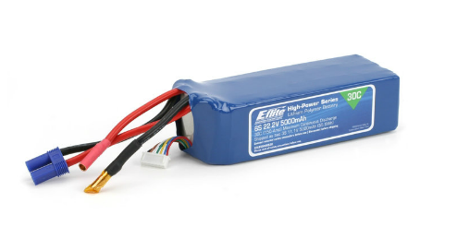
Motivation
Closely tied to battery pods effort
  Streamline charging process
Notes:
SeaBee III, an autonomous underwater robot, is powered by two 22.2V, 5000mAh lithium polymer batteries. During periods of activity, these battery packs are kept within the submarine’s pressurized hull. The pressurization, however, makes recharging the batteries a long and wasteful process; the hull must be completely depressurized before the batteries can be removed and charged. There is now an effort to move the batteries to independent housings outside the hull that will enable easier access for charging. This process also entails redesigning the circuit board that monitors and controls the batteries’ charging and discharging cycles.

Slide 4
Objectives
Protect and preserve our Li-Po batteries
Awareness of state of charge (SoC) during periods of activity
Enable charging via battery pods
Notes:
The current battery monitoring system has very limited functionality. It serves more as a hub for connections between the battery-cell leads and a circuit board that distributes power to different parts of SeaBee.
The robotics team will use the redesign effort as an opportunity to overhaul the battery monitoring boards and introduce a new set of features, including: cell-balancing, coulomb counting, over- and under-voltage alerts, and human-friendly feedback.
Cell-balancing/Coulomb Counting: the life and performance of Li-Po batteries are sensitive to their discharge cycles. Over charging them or allowing them to completely deplete will shorten the useful lifecycle of the batteries.

Slide 5
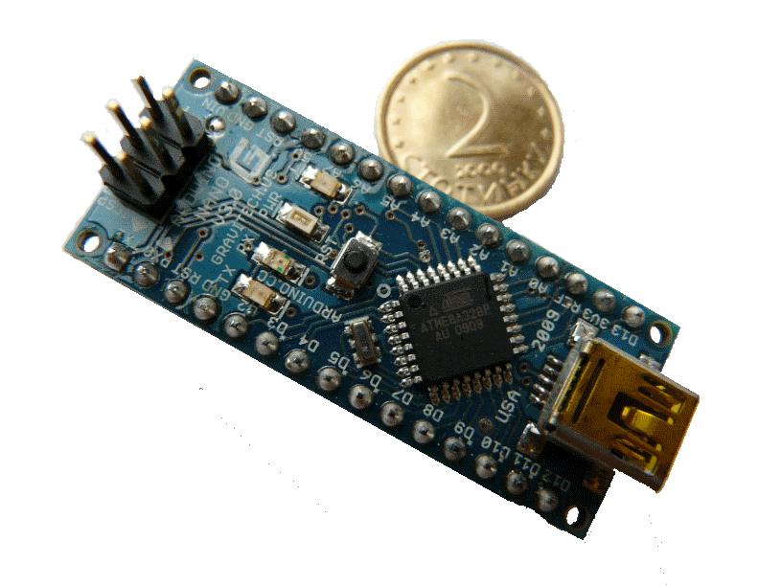
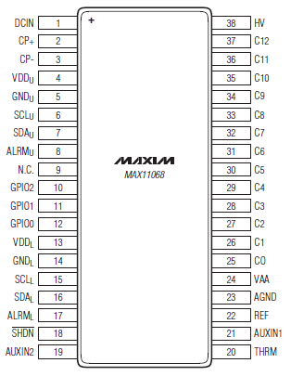
Current Design
Centered around MAX 11068 IC
Arduino Nano is primary microcontroller
Designed to give visual feedback (7-seg. disp.)
Arduino Nano
MAX 11068
Notes:
At the heart of the new design is Maxim IC’s MAX-11068 High Voltage Battery-Monitoring integrated circuit. Designed for applications in hybrid/electric vehicles, the MAX-11068 is capable of performing voltage, temperature and current measurements on 12-cell Li-Po battery packs, as well as execute a variety of support features including battery-fault detection and cell-equalization. The governing of the MAX-11068’s activities is not self-contained and must be controlled by an external master microcontroller. For example, via I²C data lines, the master device must issue the command to take state-of-charge measurements (i.e. voltage and current measurements) by setting the values of a “SCAN” and “CELLEN” registers on the MAX-11068. The master device included in the current design is an Arduino Nano, a compact, general-purpose single-board microcontroller.
The second aspect of this project is presenting the results of measurements to human operators in a meaningful and user-friendly manner. The selected media is a pair of seven-segment displays and an array of high-intensity LEDs. The seven-segment displays will display the batteries’ current state-of-charge as a numeral between 0 and 99. The LED array (a collection of red, green, blue, and yellow LEDs) will transmit the following supplementary signals: green – healthy SOC, blue – extended SOC, yellow – low SOC, red – under- or over-voltage.

Slide 6
CONTROL
Serial Data Line
Digital Signal
Arduino Nano 3.0
Power Connection
MEASUREMENT
I²C Data
I²C Data
DISPLAY
MAX 11068 Fuel Gauge
SAA1064 LED Driver
Over/Under voltage ALRM
6 cells
22.2V, 5000mAh
6-Cell Li-Po Batteries
HD-K121 7-Seg. Display
ACULED-RGBY LEDs
Notes:
The figure above demonstrates the flow of information within the system. The system's architecture is separated into three modular elements: Measurement, Control, and Display
The MAX 11068 is connected to the 6-cell battery pack and performs the necessary measurements upon receiving the command from the Arduino. The Arduino then reads the data from the fuel gauge’s memory registers, performs the appropriate SOC approximation, parses the data to a percentage value and instructs the LED driver on what value to display.

Slide 7
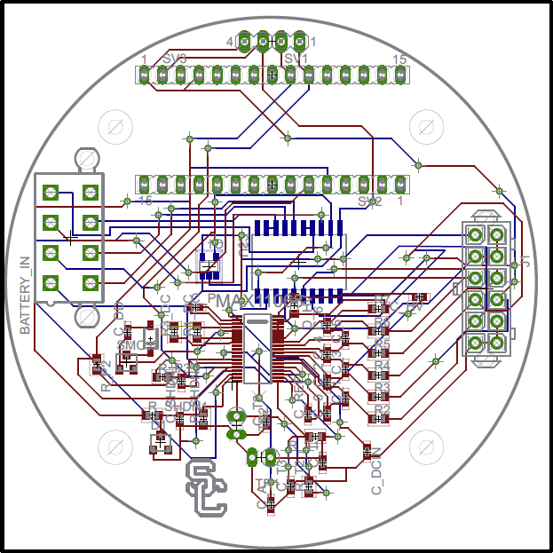
Battery Board A
Arduino Nano Slots
MAX 11068 Fuel Gauge
Notes:
This board contains the MAX-11068 and Arduino Nano. None of the elements on this board will provide any visual feedback to the human users and, thus, can sit out of view behind Battery Board B.

Slide 8
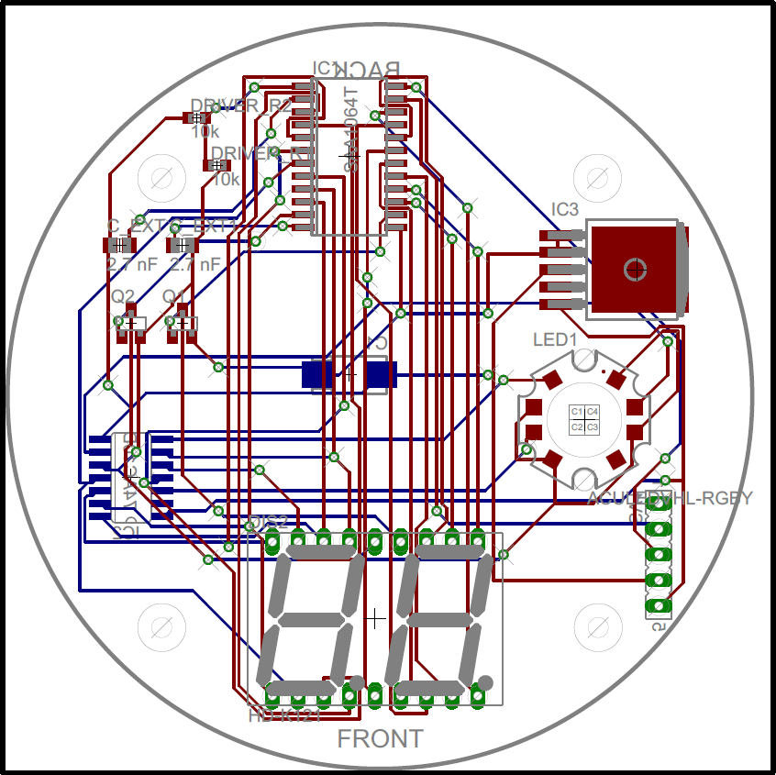
Battery Board B
SAA1064 LED Driver
ACULED-RGBY LEDs
HD-K121 7-Seg. Display
Notes:
This board contains all of the system’s display elements. The front side of this board will face the transparent end of the cylindrical housing.

Slide 9
Outlook
Assembly and Tests
  Handling High Currents
    Cell-balancing: 500 mA (continuous) limit
    Coulomb counting: A few amperes
Review and redesigns
Notes:
The current design may prove to be inadequate for the spontaneous power requirements of SeaBee III.
There is a second design currently in development based off of a different fuel gauge IC manufactured by Texas Instruments (TI BQ78PL116) that will reduce the space required for an effective visual-feedback element, allow the project to consolidate the system onto one board, and wane any concerns with high currents.

Slide 10
Goals for End of Year
First two iterations will be built, tested and integrated with SeaBee III.
Any further redesigns would be implemented during the next school year.

Slide 11
Power Board
Leah Gum and Tal Yogev
Notes:
Give a little background on what the power board is. Current setup and what it’s lacking.

Slide 12
Objectives
Redesign for new mechanical and software requirements
Increase accessibility and flexibility for future designs
Provide a well-documented design

Slide 13
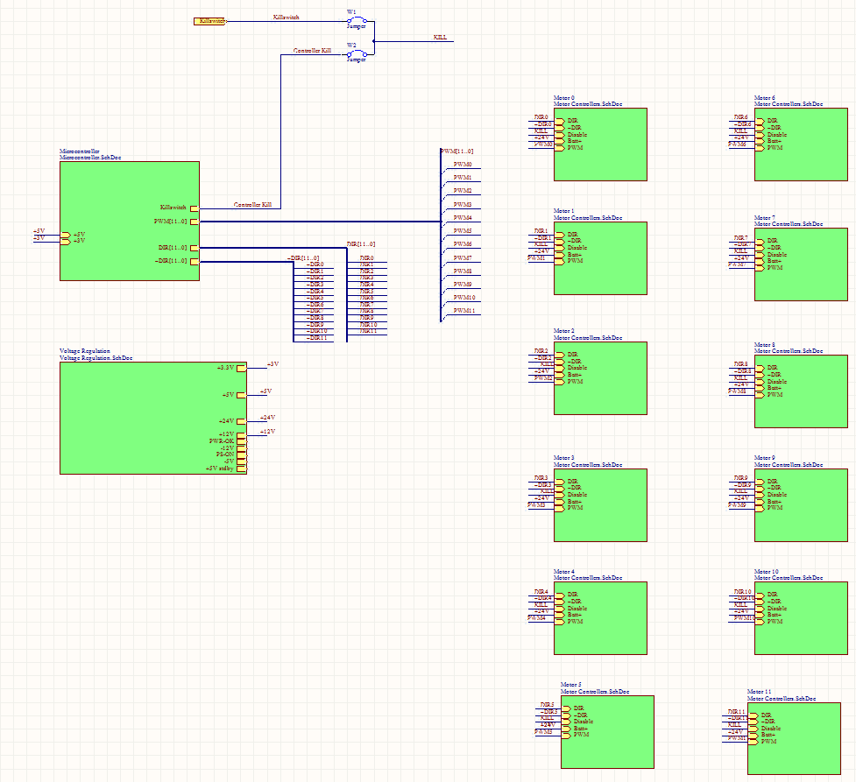
Top Level Schematic
Kill Switch
Motor Controllers
Microcontroller
Voltage Regulator
Notes:
Switched to Altium as our design tool

Slide 14
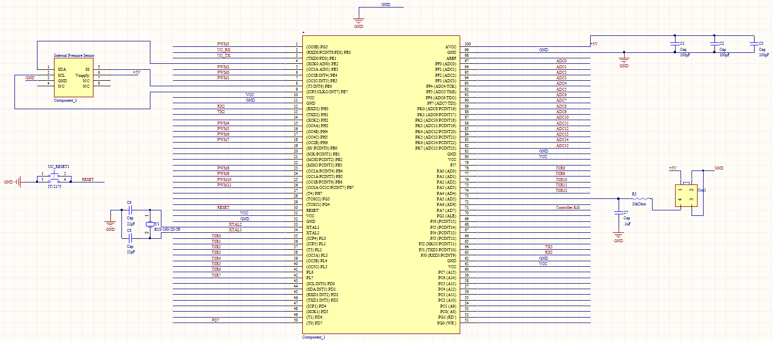
Microcontroller
Notes:
Make it clear that this microcontroller takes in input from the carrier board and manages the operation of the microcontrollers. Int./Ext. pressure
We’re moving to this chip bc we no longer have to code in SPIN (code in C) and it has more PWMs for increased motor controller capacity.

Slide 15
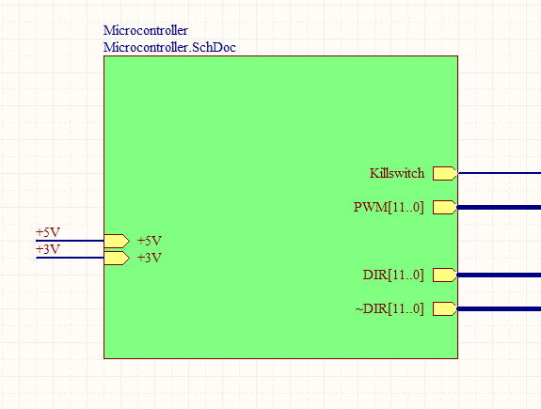
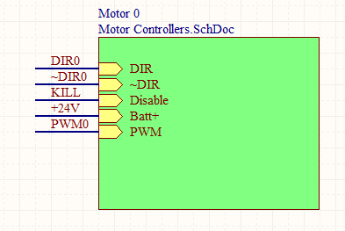
µC to Motor Controller Interface
x12

Slide 16
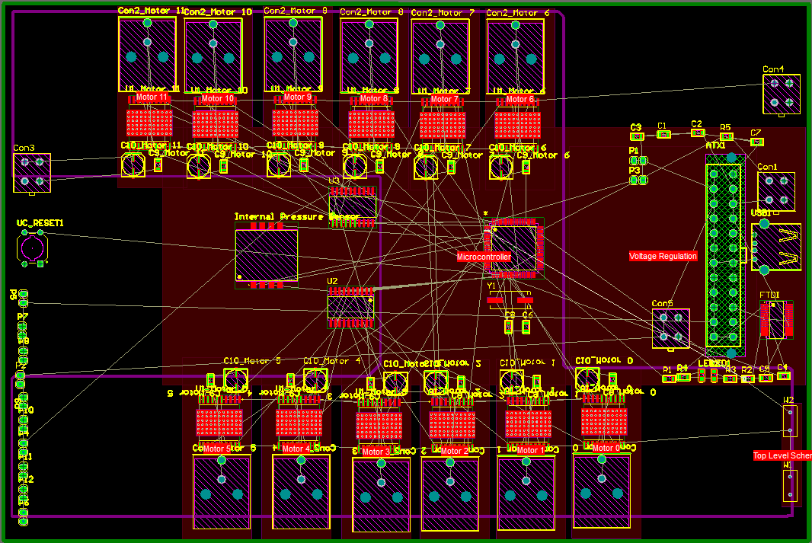
PCB Layout
Notes:
Con1, top right, external pressure sensor
USB, middle right, USB connection

Slide 17

Questions/Recommendations?
Notes:
Recommendations for additional components?
Or for improving the modularity of the device?

Slide 18
Passive Sonar
Dylan Foster, Jose Herrera, Derek Lim, Hieu Nguyen, Alex Onopa
Notes:
The passive sonar project is an important area of focus this year. As you can see, we have quite a few people contributing to the development of a new sonar system, which will include new methods for signal filtering, ping detection, and angle-of-arrival calculations. In the past, our team has been unsuccessful in completing the sonar task, which has proven to be essential for placing well in the Robosub Competition.

Slide 19
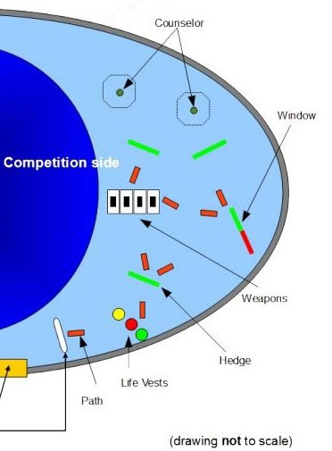
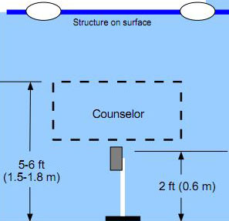
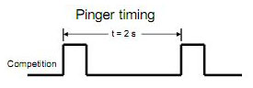
Task Overview
Notes:
If you recall the diagram of the competition pool, there are two floating octagon structures at the end of the run. Beneath each octagon, there is a PVC structure—which in this case is called the “Counselor”—and also an acoustic pinger [show pinger] mounted on a pole 2 feet off the floor. At the start of each run, one of the two pingers will be turned on to designate the proper Counselor and octagon for perform the sensing and manipulation tasks.
The pinger emits a 20-30kHz ping every 2 seconds. Our job is to passively detect the ping signal, and accurately guide SeaBee to the correct octagon.
The ping duration is 1.3ms at 0.5Hz (every 2 seconds).

Slide 20
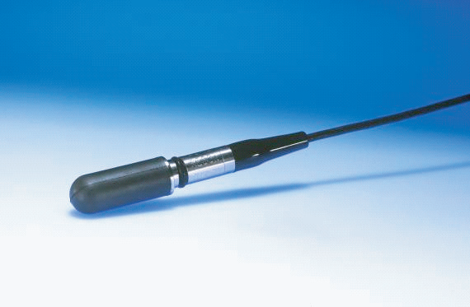
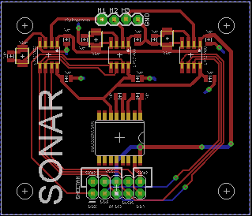

Previous “Solution”
3-hydrophone array
12-Bit, 400ksps ADC
Cheetah SPI Host Adapter
Digital FFT, ping detection
Issues:
  Signal strength, noise
  H-phones common ground
Notes:
Last year’s approach involved using a triangular array of 3-hydrophones and passive electrical components to isolate and amplify the energy of a wave packet. The signals from the hydrophones were digitized using ADCs, and a Cheetah SPI Host Adapter (an off-the-shelf high-speed communication tool for facilitating the data streaming over an SPI serial bus). The digital information was processed by a microcontroller for its frequency content, and a ping-detection algorithm was used. This involved extracting the phase information and converting the time-difference-of-arrival into an angle towards the pinger.
This approach worked well in simulation, but had difficulties in implementation. The main issues were signal strength and signal noise. For example, we think one design flaw was that the hydrophones were all connected together to a common ground, which caused some interference and cross-talk.

Slide 21
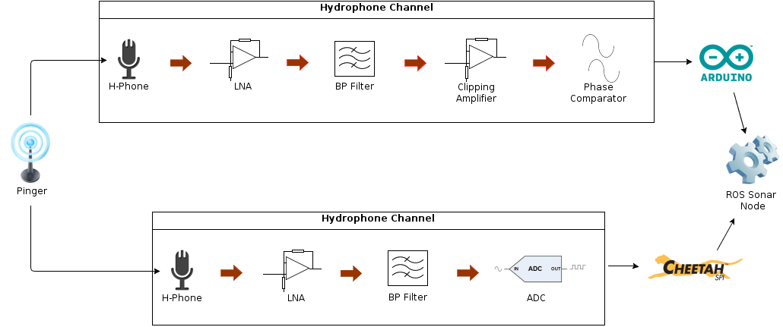
Current Approach
Switched-capacitor filter, signal clipping, phase compare
AFE improvement of last year’s Cheetah solution
Notes:
This year, we are exploring two different approaches for sonar. One approach is based off an idea from another team, which uses a narrow switched capacitor bandpass filter to isolate the 20-30kHz ping signal, an amplifier to clip the signal (essentially turning it into a square wave), and a phase comparator to determine the phase differences between the different hydrophone channels. The phase comparators will output a pulse width proportional to the phase difference, which is then read by an Arduino microcontroller.
The second approach is an analog frontend improvement of last year’s Cheetah solution. The grounds of each hydrophone channel will be kept separated, and differential-pair hardware will be used to reduce the interference, cross-talk, and external noise. The signals from the hydrophones can be very weak so a low-noise preamplifier will be used to boost and condition the signal for the bandpass filter. Also, faster and more precise ADCs will be used, and a fourth hydrophone will be incorporated into a tetrahedron-like configuration to add another dimension to our calculations.

Slide 22
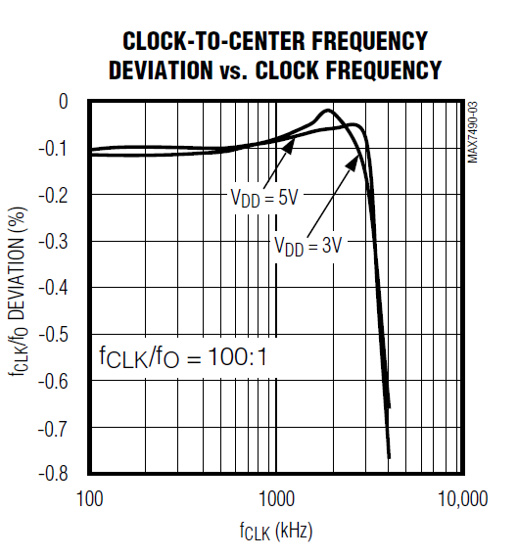
Switched Capacitor Filter
Bandpass filter with a variable center frequency.
Center frequency determined by supplied clock frequency.

Slide 23
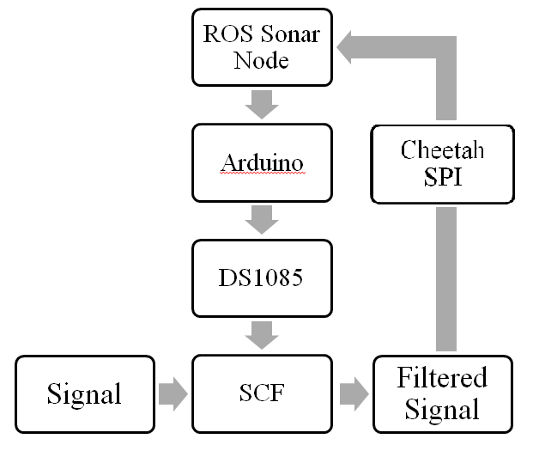
Maxim DS1085 Frequency Synthesizer
Range: 8kHz – 133MHz, 10kHz steps.
Arduino communicates with DS1085 using I²C interface.
Allows us to control bandpass frequency from ROS node.

Slide 24
Filter Issues
Haven’t been able to get sample IC’s to work properly.
High frequency issues?
Post-filter signal path still undetermined.

Slide 25
Localization
We will use simple geometry to acquire the relative angle of the sub and the pinger
This is accomplished by analyzing the trigonometric relationship of time delay between the signal in the first and second hydrophone and the sub's orientation.

Slide 26
T1

Slide 27
T1
a
(T₂-T₁)∙V_{w}
T2

Slide 28


Pinger
Hydrophone 1
a
(T₂-T₁)∙V_{w}
θ
θ
Hydrophone 2

Slide 29
Issues To Be Solved
Technical advice on:
  DAQ Board
    Overall signal path: ensuring a clean signal from H-phones
    Filtering out external noise from the pool and from SeaBee
  Pinger-finding Algorithm
    Using phase difference or time-difference-of-arrival to locate the pinger
Notes:
We are currently prototyping our designs for the individual components of the signal path, but still face the difficult task of integration. While we're still in the design phase, any technical advice for ensuring a clean signal from the hydrophones, combating external noise, or developing the pinger-finding algorithm is appreciated. We want to make sure that our system works reliably, so that we can accomplish the sonar task and compete with the top contenders of the RoboSub competition.

